Slide 1

This is your presentation title
TEAM 35

Slide 2









Understanding the Data & Problem Statement
Exploratory Data Analysis
Feature Selection
12227 songs
Each song has several parameters like acousticness,duration,year etc
Each Song ranked on a scale of 1 to 5 according to popularity
Predict the popularity of each song
Anomaly Detection
INSIGHTS
Classification Models
Release-Date and Year column are highly correlated
Imbalance in Dataset
The very high popularity constituted 3% of the total dataset
Comparative Analysis
Conclusion
Random oversampling was used to treat the imbalance in dataset.This method randomly duplicate examples in the minority class.

Slide 3
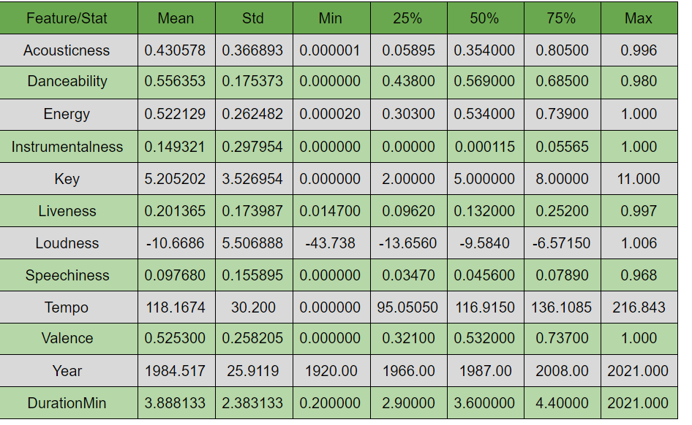
Understanding the Data & Problem Statement
Exploratory Data Analysis
DATA SUMMARY
Feature Selection
Anomaly Detection
Classification Models
Comparative Analysis
Conclusion

Slide 4
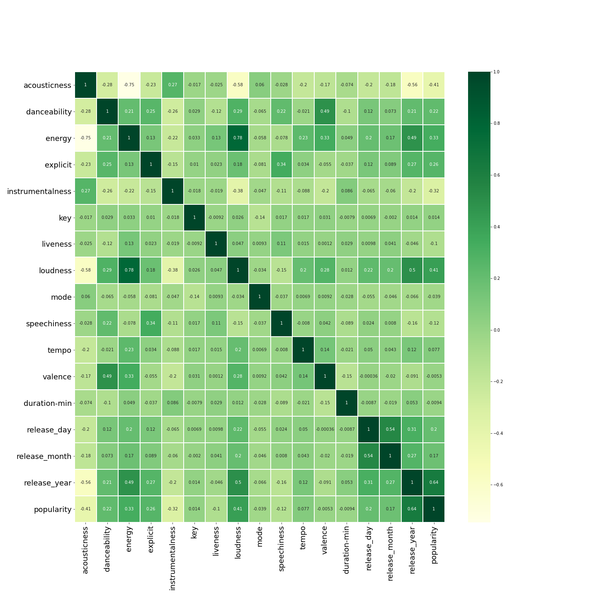


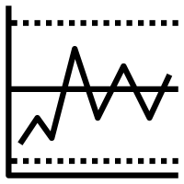
Data Visualization and insights
Exploratory Data Analysis
CORRELATION MATRIX
Feature Selection
Anomaly Detection
Loudness and Energy of a song are highly positively correlated.
Classification Models
Comparative Analysis
Conclusion
Acousticness is highly negatively correlated with the energy and loudness of the song

Slide 5
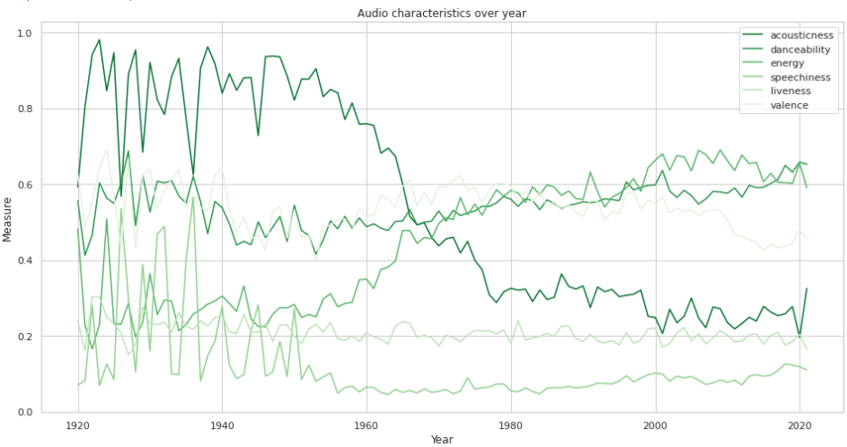
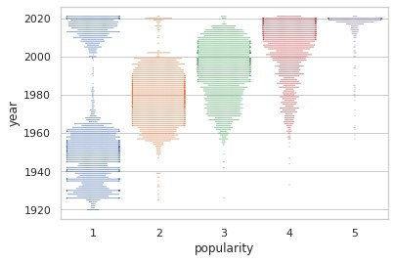
Data Visualization and insights
Exploratory Data Analysis
Feature Selection
Acousticness in songs decreased over the years.
Energy increased over the years. Similarly, the loudness and the tempo of the songs increased over the years
Anomaly Detection
Classification Models
Comparative Analysis
We can see the majority of the songs having very high popularity are from 2015 onwards
Conclusion

Slide 6
Feature Selection
Exploratory Data Analysis
Feature Selection
Variance threshold
SelectFromModel
Anomaly Detection
Any feature having variance less than a threshold is removed from the dataset
Selects a given number of features based on the importance weights
Top Features
Year
Danceability
Instrumentalness
Duration-min
Valence
Acousticness
Liveness
Classification Models
SelectKBest
Greedy Feature Selection
Comparative Analysis
Select features according to the k highest scores where the scoring function was ANOVA
Selects features greedily one by one on the basis of which feature the evaluation metric increases the most.
Conclusion
Conclusion

Slide 7
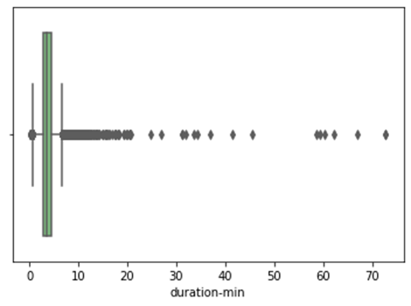
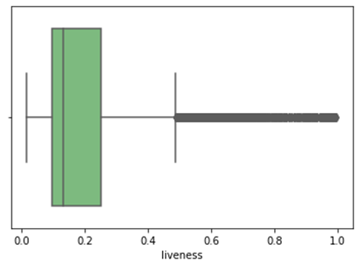
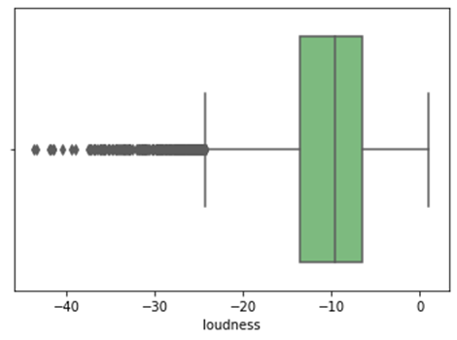
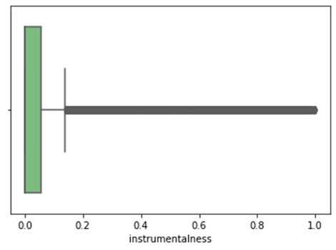
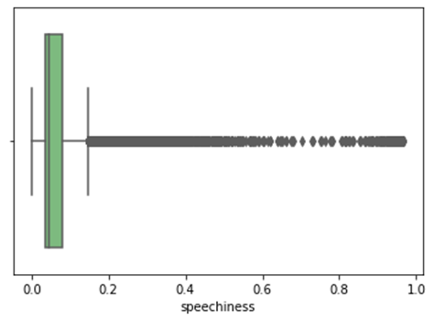
Anomaly Detection
Exploratory Data Analysis
Duration-min: 5.48 %
Liveness: 7.07 %
Feature Selection
Anomaly Detection
Loudness : 2.23 %
Instrumentalness: 21.63 %
Classification Models
Comparative Analysis
The outliers constituted 50% of the dataset so removing them wasn’t an option.
Did not treat the outliers as decision tree models were trained and outliers wouldn’t affect the model much.
Speechiness: 13.92 %
Conclusion

Slide 8
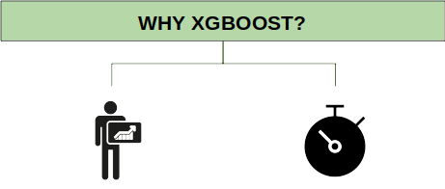
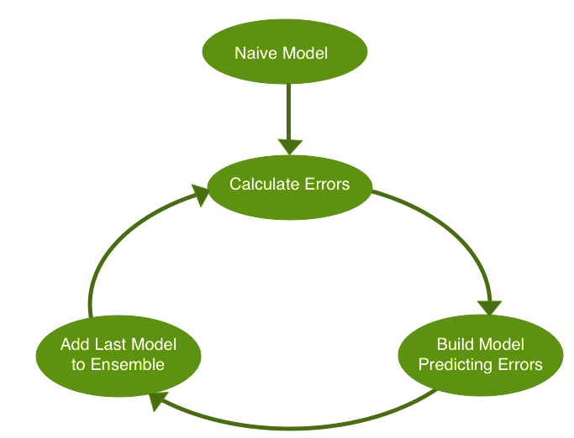
XGBoost ( eXtreme Gradient Boosting)
Exploratory Data Analysis
XGBoost is an optimized distributed gradient boosting library designed to be highly efficient, flexible and portable.
It implements machine learning algorithms under the Gradient Boosting framework.
Feature Selection
Anomaly Detection
Classification Models
Test Accuracy | 71.2
Training Accuracy | 99.95
Bidding Value | 7540
Revenue Collected | 12488
F1-score | 0.688
Comparative Analysis
Conclusion

Slide 9

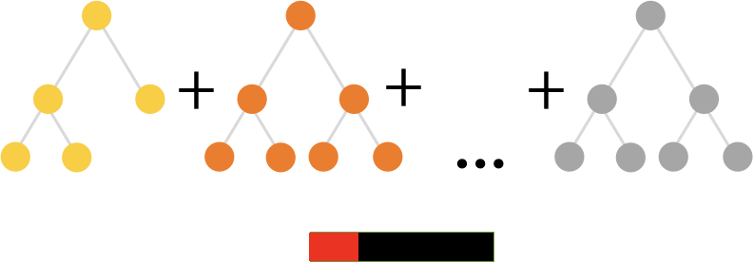
CatBoost
Exploratory Data Analysis
CatBoost grows oblivious trees, which means that the trees are grown by imposing the rule that all nodes at the same level, test the same predictor with the same condition, and hence an index of a leaf can be calculated with bitwise operations
Why Catboost?
Feature Selection
Anomaly Detection
Classification Models
Test Accuracy | 68.00
Training Accuracy | 77.05
Bidding Value | 7539
Revenue Collected | 13972
F1-score | 0.656
Comparative Analysis
Conclusion

Slide 10

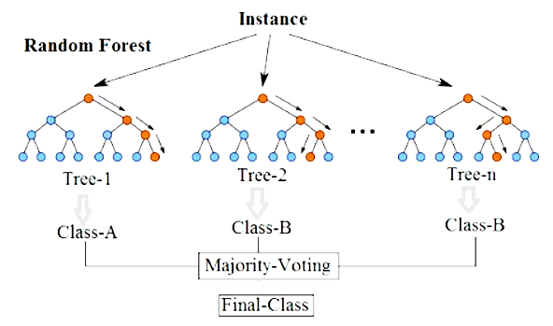
Random Forest
Exploratory Data Analysis
Random Forest operates as an ensemble of a large number of decision trees.
In this algorithm, all the trees spit out the prediction and the class with the most number of votes becomes the model’s prediction.
Why Random Forest?
Feature Selection
Anomaly Detection
Classification Models
Test Accuracy | 71.35
Training Accuracy | 99.95
Bidding Value | 7538
Revenue Collected | 14086
F1-score | 0.704
Comparative Analysis
Conclusion

Slide 11

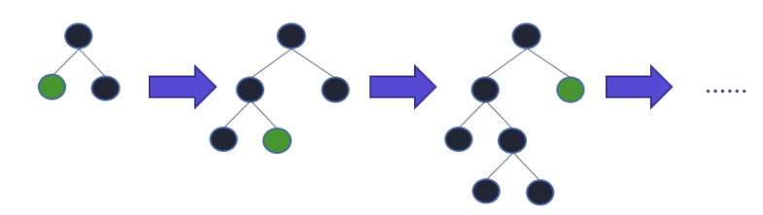
LightGBM
Exploratory Data Analysis
LightGBM is called “Light” because of its computation power and giving results faster.
Light GBM grows tree vertically i.e leaf-wise. It takes less memory to run and is able to deal with large amounts of data
Why LightGBM?
Feature Selection
Anomaly Detection
Classification Models
Test Accuracy | 70.05
Training Accuracy | 89.95
Bidding Value | 7538
Revenue Collected | 14046
F1-score | 0.686
Comparative Analysis
Conclusion
Notes:
The final model we used on our dataset was LightGBM.
It has lower memory usage (Replaces continuous values to discrete bins which result in lower memory usage).
It gives better accuracy than any other boosting algorithm as it produces much more complex trees by following leaf wise split rather than level-wise approach.
It is also compatible with large datasets.
So the results achieved are as follows -> The test accuracy is 70% while the training accuracy is 88% which shows that our model isn’t overfitting as much as in previous cases. The F1 score is also 0.686 which is decent.
And the revenue collected is 14046$ for a bidding value of 7540$ in the for the validation dataset.

Slide 12
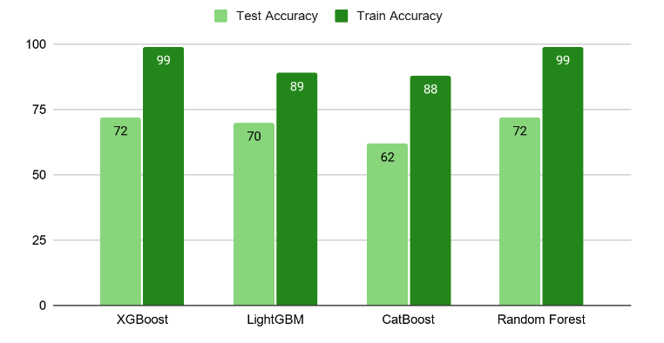
Comparative Analysis
Exploratory Data Analysis
Feature Selection
Anomaly Detection
Classification Models
Comparative Analysis
Since both XGBoost and Random Forest models are overfitting, and the score of CatBoost is less, we are going to choose LightGBM as our final model.
Conclusion
Notes:
This is the comparative analysis of all the models and approaches which we have used and we observe that XGBoost and Random Forest even though they had a greater F1 score and accuracy, they were overfitting. That is there performance would have been bad on the test dataset.
Even though CatBoost wasnt overfitting, the scores were very low. Therefore we chose LightGBM as our best model.

Slide 13

Conclusion
Exploratory Data Analysis
Feature Selection
Class | Precision | Recall | F1-score
Very Low | 0.56 | 0.68 | 0.62
Low | 0.84 | 0.81 | 0.82
Average | 0.47 | 0.46 | 0.47
High | 0.67 | 0.47 | 0.55
Very High | 0.90 | 0.98 | 0.97
Anomaly Detection
Classification Models
Comparative Analysis
The bidding total of the model on our validation set of size 3016 rows is $7538, and the revenue collected is $14046.
Our model has good predictions for Very High and Low popularity, which is visible in our classification report of the LightGBM model
Conclusion
Notes:
Based on the revenue collected and train and test accuracy as well as F1 scores of XGBoost, LightGBM, Random Forest and CatBoost models, we chose LightGBM to be our final model.
The bidding total of the model on our validation set of size 3016 rows is $7538, and the revenue collected is $14046. The formula for the bidding limit was (length of validation dataset*(10000/4000))
Our model has good predictions for Very High and Low popularity, which is visible in our classification report of the Light GBM model. Because of this, we have a high revenue collection in our validation dataset.
Precision is the ratio between the True Positives and all the Positives (TP/(TP+FP))
The recall is the measure of our model correctly identifying True Positives. (TP/(TP+FN))
Accuracy is the ratio of the total number of correct predictions and the total number of predictions

Slide 14
THANK YOU

Slide 15
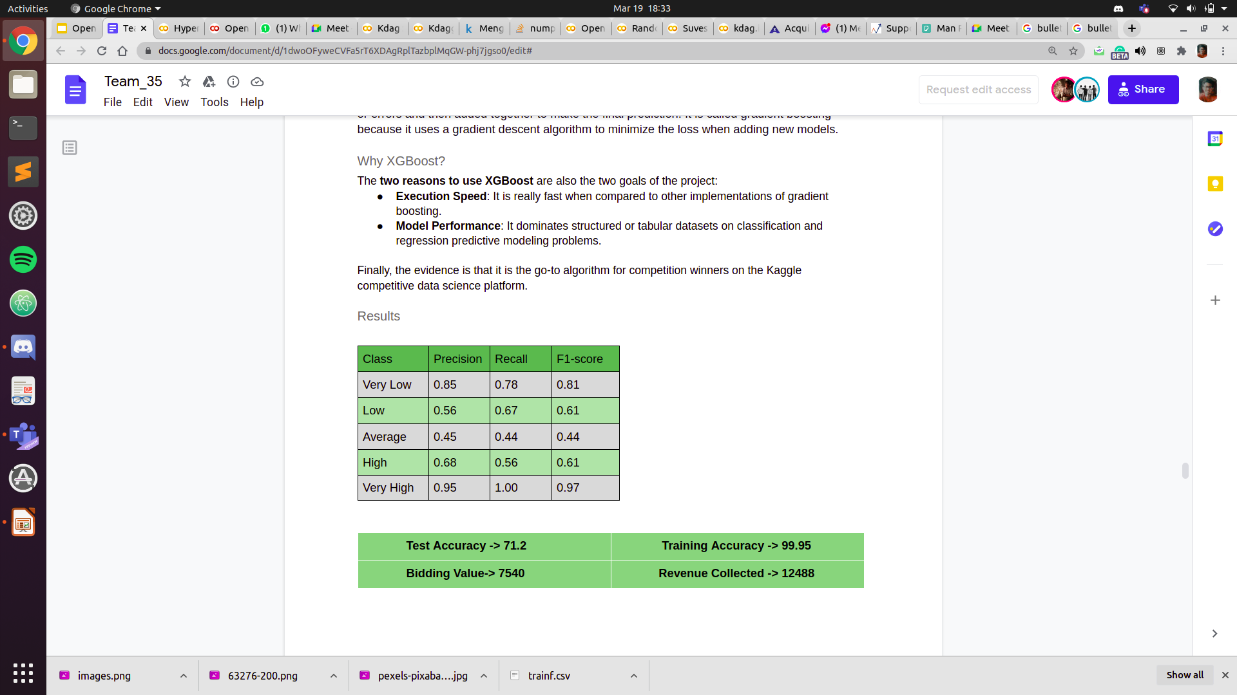
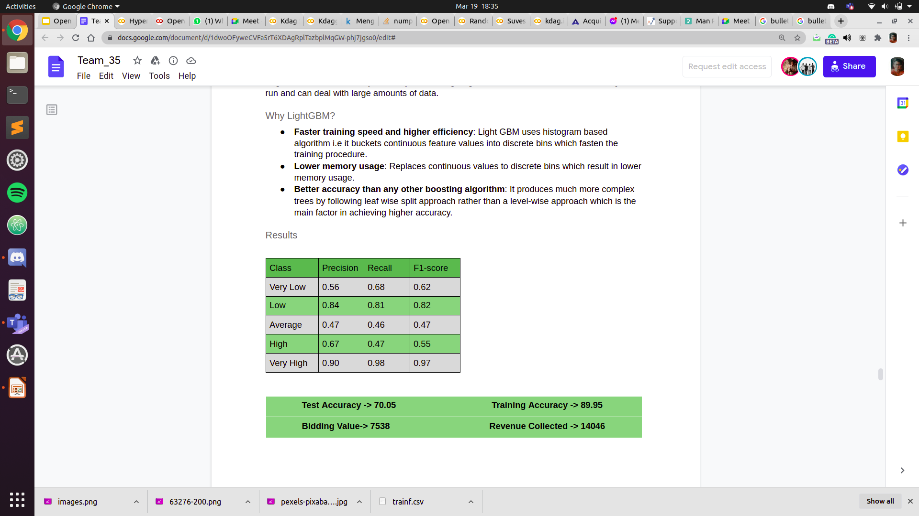
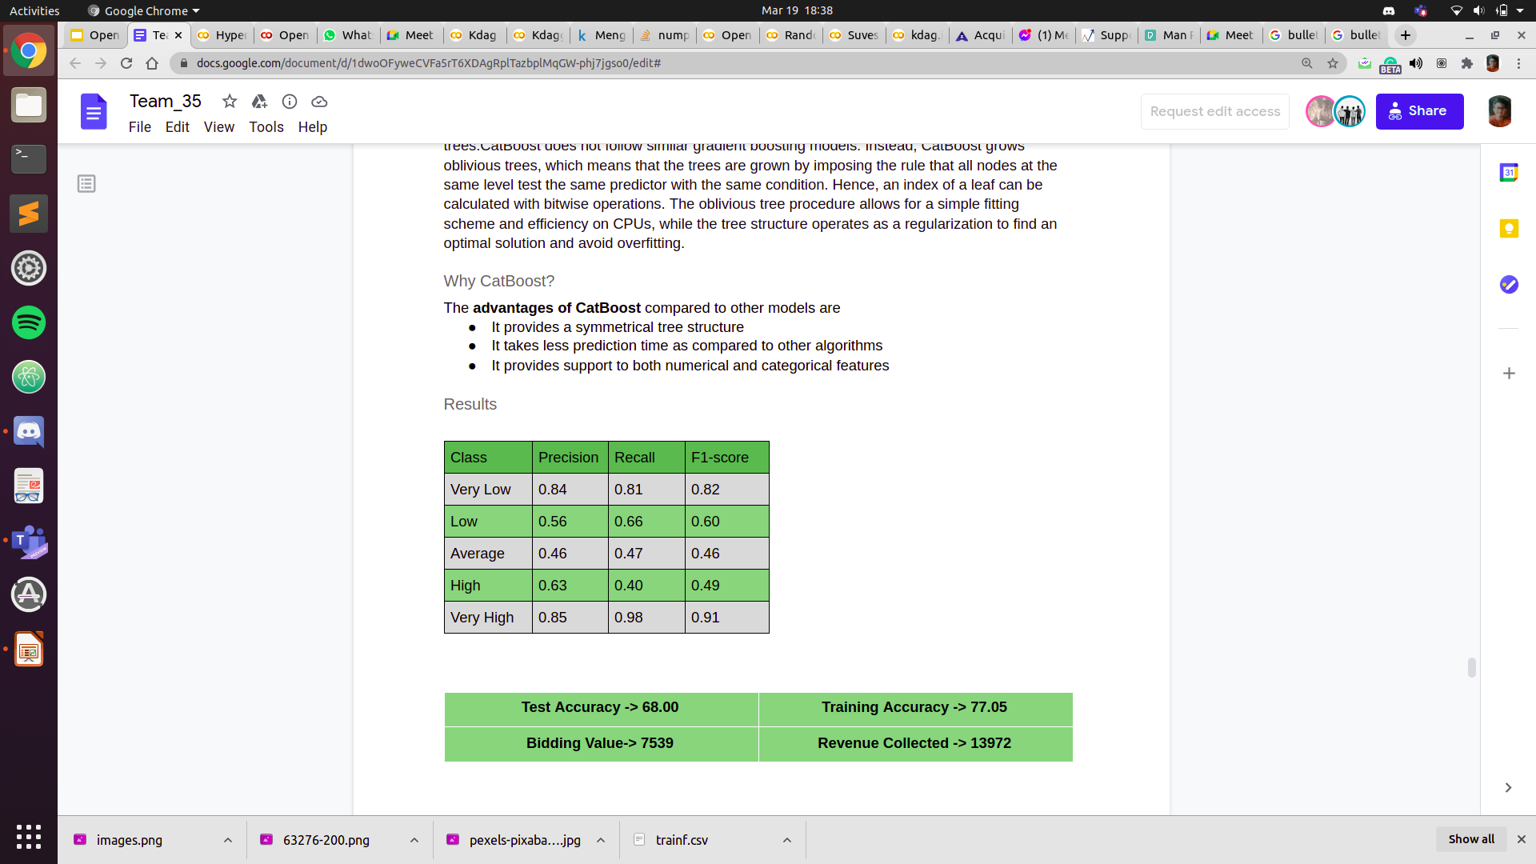
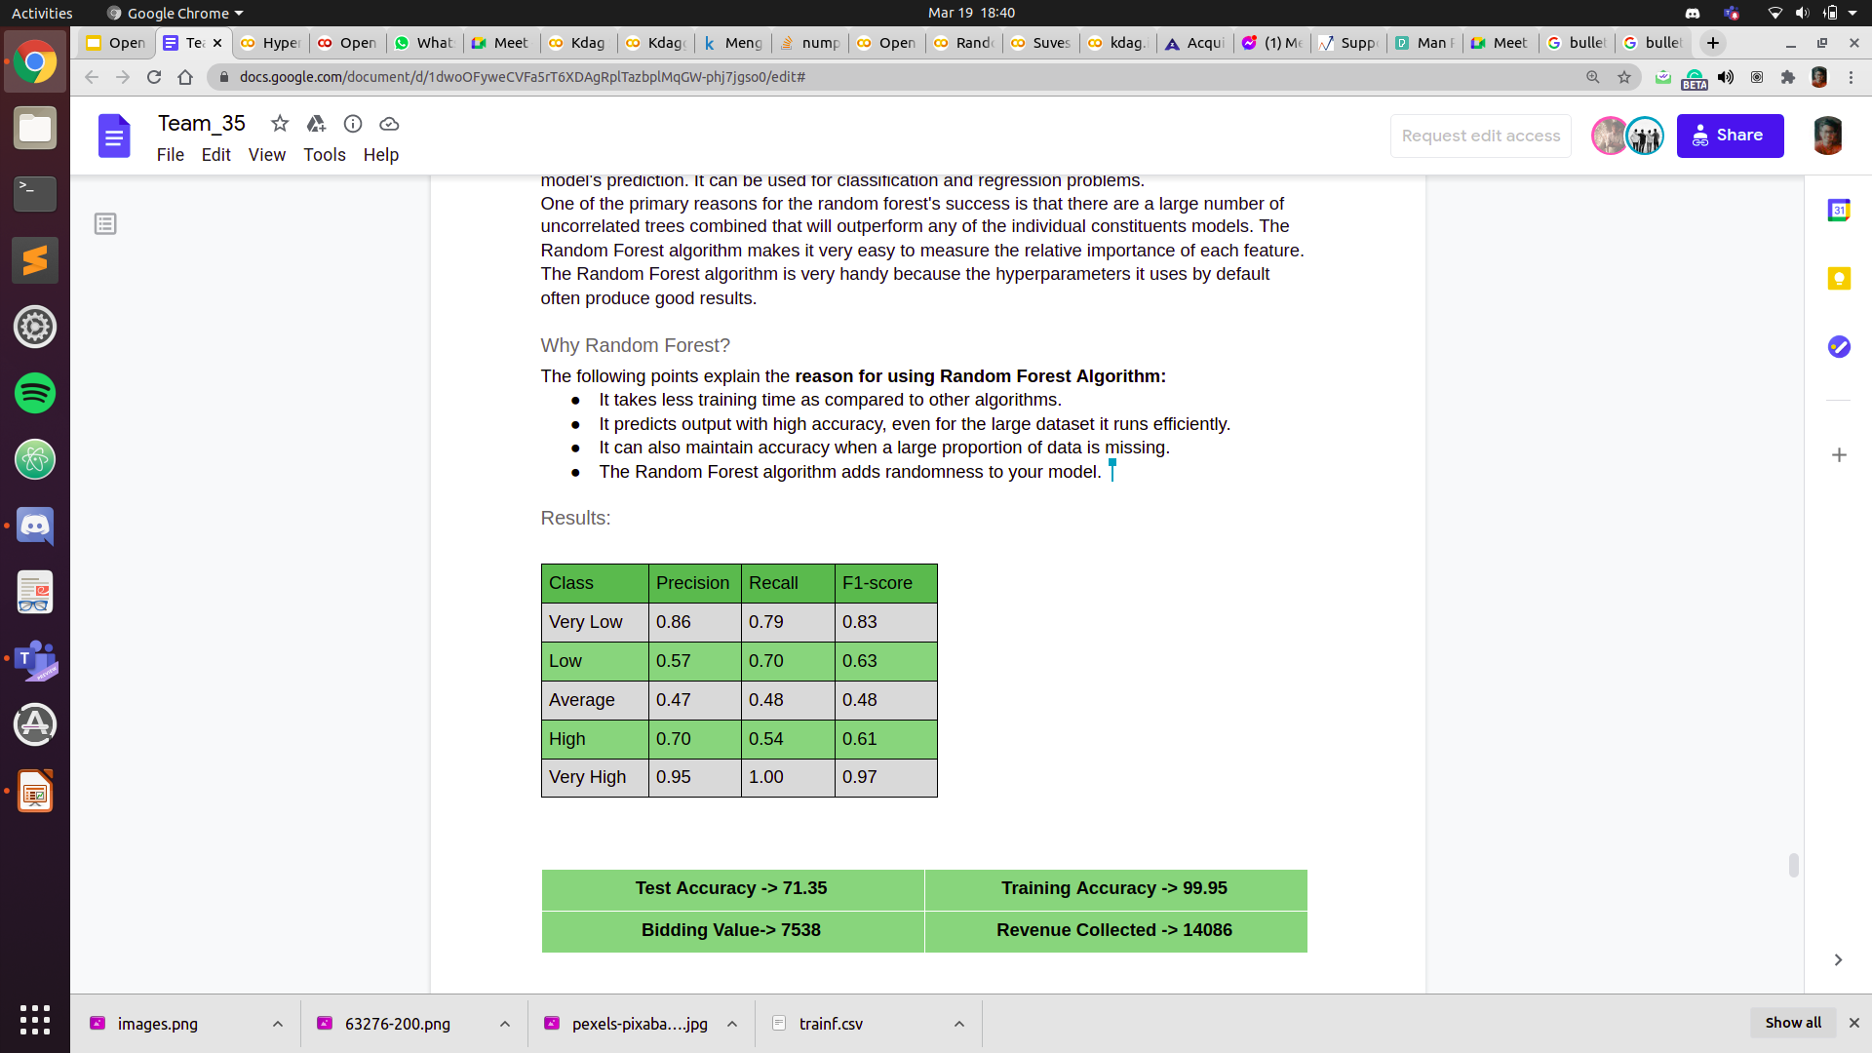
XGBoost
LightGBM
Exploratory Data Analysis
Feature Engineering
Anomaly Detection
Classification Models
CatBoost
Random Forest
Comparative Analysis
Conclusion

Slide 16
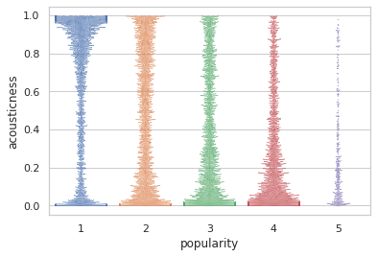
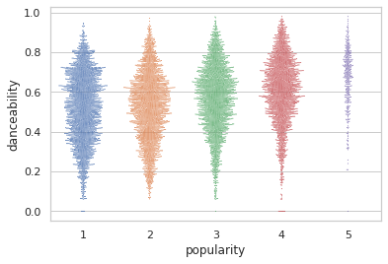
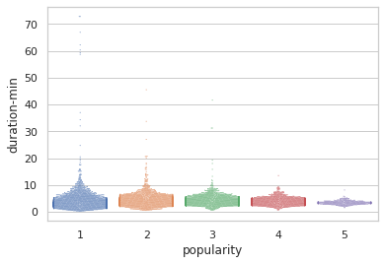
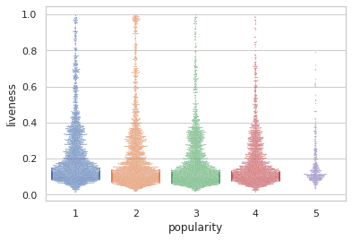
Exploratory Data Analysis
Feature Engineering
Anomaly Detection
Classification Models
Comparative Analysis
Conclusion

Slide 17
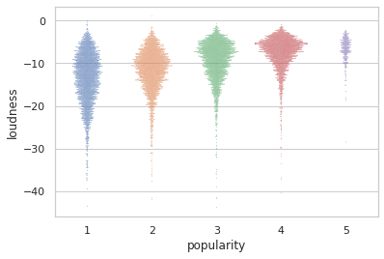
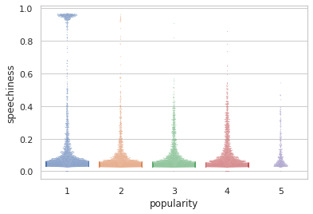
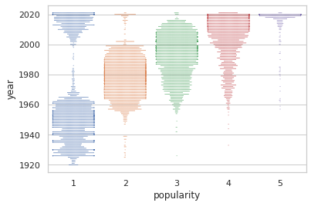
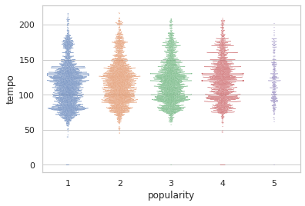
Exploratory Data Analysis
Feature Engineering
Anomaly Detection
Classification Models
Comparative Analysis
Conclusion

